Slide 1

Use Case 1: Chronic Disease Management Portal
Full Stack Developer Hackathon
Groups size – 2-3 Preferably 3

Slide 2
Problem Statement
Develop a full stack solution for a Chronic Disease Management Portal that seamlessly integrates front-end and back-end technologies.
The portal should assist patients and healthcare providers in managing chronic conditions like diabetes or hypertension. The portal should focus on tracking essential health metrics, providing basic health insights, and fostering communication between patients and providers.
The solution should prioritize simplicity, usability, and compliance with healthcare standards, making it achievable within a 5-hour timeframe.
Scope for 5-Hour MVP:
Deliver a lightweight Minimum Viable Product (MVP) that highlights core features: secure authentication, health metric tracking, and a basic communication system

Slide 3




Technical Requirements
1. Frontend:
Angular for the user interface
Basic styling with CSS modules or Sass
2. Backend
Node.js with Express.js, Java Spring boot or .NET core for the API server
NoSQL database of choice (e.g., MongoDB, DynamoDB, Firestore)
3. Authentication
JWT for secure user sessions
Implement role-based access control (patient vs. healthcare provider)
4. API:
RESTful API for communication between frontend and backend
5. Cloud Deployment:
Deploy frontend and backend to cloud platforms of choice
Set up basic environment variables for configuration
6. CI/CD:
Implement a basic GitHub Actions workflow for automated testing and deployment

Slide 4
Key Features to Implement
1. Secure Authentication System:
Implement login and registration for patients and healthcare providers
JWT-based session management with appropriate expiration
Password hashing and security measures
2. Patient Dashboard:
Essential Metrics Display:
Track and view key health metrics (e.g., blood sugar levels, blood pressure, weight).
Visualize recent trends in a simple chart format (last 7 days).
Health Tips:
Basic advice relevant to the patient’s condition (e.g., "Stay hydrated" for diabetes).
3. Profile Management:
Allow patients to view and edit their profile information
Include fields for basic health information (e.g., allergies, current medications)
4. Healthcare Provider View:
List of assigned patients with their recent health metrics and status (e.g., "Stable" or "Needs Attention").
Click to view detailed metric history for a specific patient.
5. Metric Submission for Patients
Simple form for patients to log daily metrics (e.g., blood sugar level, blood pressure).
6. Basic Messaging System
Allow patients to send a short message to their provider.
Providers can respond with general advice or next steps.
7. Privacy and Security Measures:
Implement logging for user actions related to data access
Add a consent checkbox for data usage during registration

Slide 5
Architecture and DevOps Considerations
Design a scalable architecture separating frontend, backend, and data layers
Implement proper error handling and logging
Ensure secure data flow between frontend and backend
Set up a cloud-based NoSQL database instance
Configure environment variables for sensitive information
Implement basic HIPAA compliance measures (e.g., data encryption, access controls)

Slide 6
MVP Deliverables
MVP Deliverables:
Functional authentication system for patients and providers
Patient dashboard to display and log health metrics.
Provider dashboard to monitor patients’ metrics.
Basic messaging system for patient-provider communication.
Deployed frontend and backend applications
Functional CI/CD pipeline with basic automated tests
Additional Considerations:
Prioritize security and privacy features over complex functionalities
Demonstrate understanding of healthcare data protection requirements
Be prepared to explain architectural decisions and their impact on security and performance
Focus on creating a coherent, if limited, user experience that showcases personalization

Slide 7
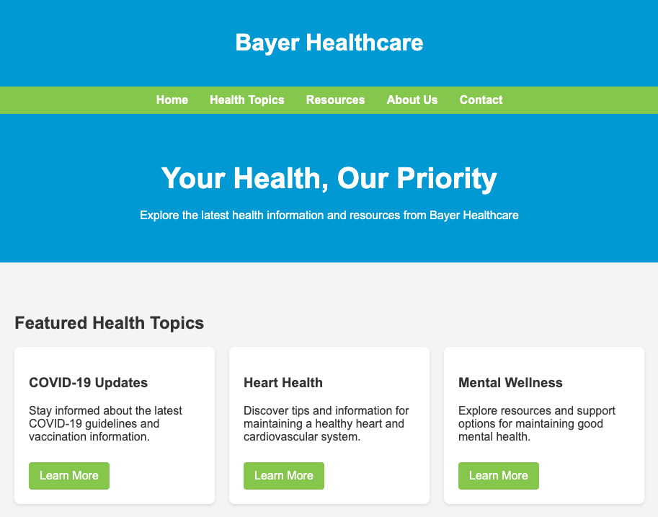
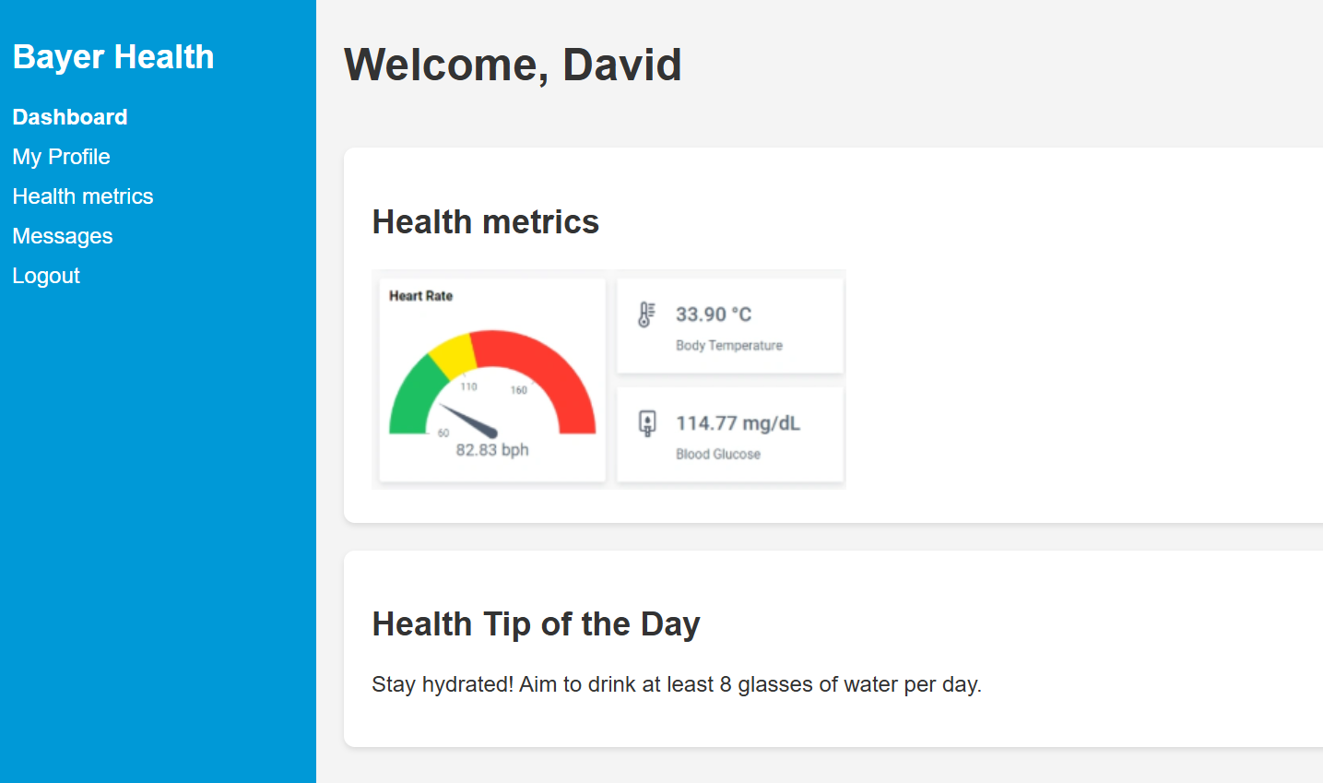
Mock Designs

Slide 8
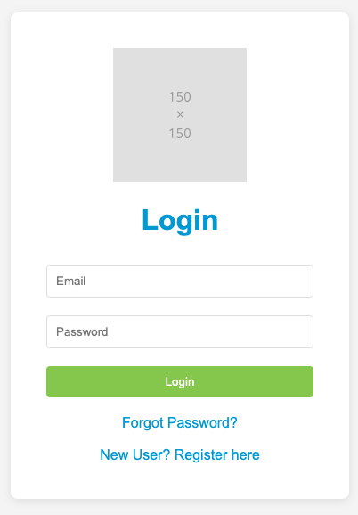
Mock Designs

